Slide 1

Programming Concepts II
HILT 2019

Slide 2
Today: Python LEVEL 2
Some review (always helpful!)
Loops (doing things repeatedly!)
Comprehensions (more efficient code!)
Conditionals (if then!)
Making our own methods (reusing code!)
…and also:
Practice exercises with our newfound Python powers (such power!!)

Slide 3
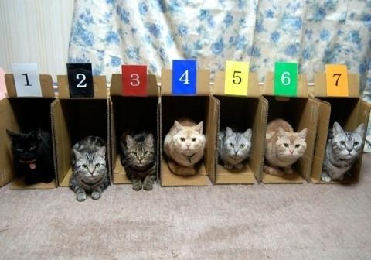
Collections

Slide 4
Collections
List:
>>> fruits = ["kiwi", "strawberry", "plum"]
>>> fruits
['kiwi', 'strawberry', 'plum']
fruits[0] = "kiwi", fruits[1] = "strawberry", etc.
Dictionary (associative array):
>>> states = {"VA": "Virginia", "MD": "Maryland"}
>>> states
{'VA': 'Virginia', 'MD': 'Maryland'}
states["VA"] = "Virginia", states["MD"] = "Maryland"

Slide 5
Loops & Iterators:
repeating yourself!
>>> fruits[0]
'kiwi'
>>> fruits[1]
'strawberry'
>>> fruits[2]
'plum'
this isn't fun or efficient!

Slide 6
for loop: Do something repeatedly
for fruit in fruits:
print(fruit)
kiwi
strawberry
plum
Note: indentation matters! Keeps things organized.
Tabs vs Spaces
Notes:
The parentheses are implied but unnecessary around fruit
Explain what |fruit| does

Slide 7
for loop: Do something repeatedly
for fruit in fruits:
print(fruit)
for X in Y:
do_a_thing
Y is the collection you're working with.
X is our name we will give for each individual item as we step over them.
Notes:
The parentheses are implied but unnecessary around fruit
Explain what |fruit| does

Slide 8
for loop: Do something repeatedly
for fruit in fruits:
print(fruit)
for thing in fruits:
print(thing)
for this_one in fruits:
print(this_one)
Notes:
These should all output the same thing.

Slide 9
for loop: Do something repeatedly
for nugget in fruits:
print(nugget)
for thing in fruits:
print(thing)
for this_one in nuggets:
print(this_one)
Error! Why is that?
Notes:
These should all output the same thing.

Slide 10


Slide 11
Comprehensions
results = []
for item in fruits:
results.append(item)
results
results now is a list consisting of some changes made to the first list.
Notes:
These should all output the same thing.

Slide 12
Comprehensions
numbers = [1,2,3,4,5]
results = []
for item in numbers:
results.append(item + 5)
results
results now is a list consisting of each number in the first list, with some changes
Notes:
These should all output the same thing.

Slide 13
Comprehensions
numbers = [1,2,3,4,5]
results = []
for item in numbers:
results.append(item)
results
We can shorten this! 3 lines in 1:
results = [item for item in numbers]
or
results = [item + 5 for item in numbers]
Notes:
These should all output the same thing.

Slide 14
Comprehensions
Keep in mind that we can call the current point in the loop anything we want:
results = []
for nugget in numbers:
results.append(nugget)
results
or
results = [nugget for nugget in numbers]
Notes:
These should all output the same thing.

Slide 15
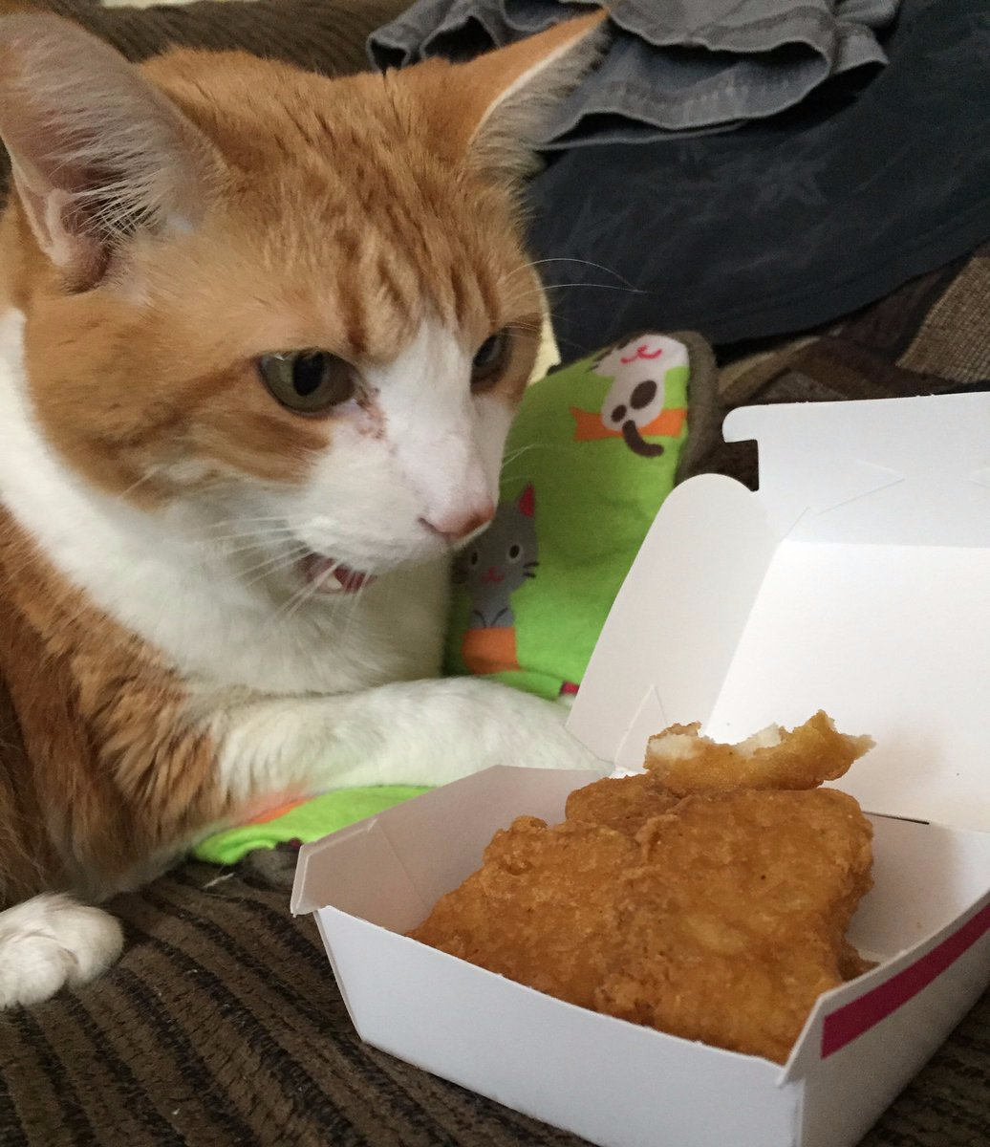

Slide 16
Comprehensions
numbers = [1,2,3,4,5]
results = []
for item in numbers:
results.append(item + 5)
results
or
numbers = [1,2,3,4,5]
results = [item + 5 for item in numbers]
Quick! Easy! but confusing!
Notes:
These should all output the same thing.

Slide 17
Comprehensions
Use a list comprehension to simplify this:
names = ['Brandon', 'Ethan', 'Tony']
results = []
for name in names:
results.append('Hi my name is' + name)
results
Notes:
These should all output the same thing.

Slide 18
Comprehensions
Use a list comprehension to simplify this:
names = ['Brandon', 'Ethan', 'Tony']
results = []
for name in names:
results.append('Hi my name is ' + name)
Answer:
results = ['Hi my name is ' + item for item in names]
or
results = ['Hi my name is ' + name for name in names]
Notes:
These should all output the same thing.

Slide 19
Exercise
1. Given a list of 5 numbers, use a for loop to create a new list named "data" that consists of the original numbers but with 10 subtracted from each of them.
2. Do the same thing, but simplify your code so that it uses a list comprehension.
Notes:
These should all output the same thing.

Slide 20
Comprehensions
1. Given a list of 5 numbers, use a for loop to create a new list named "data" that consists of the original numbers but with 10 subtracted from each of them.
2. Do the same thing, but simplify your code so that it uses a list comprehension.
my_list = [1,2,3,4,5]
data = []
for cosmos in my_list:
data.append(cosmos - 10)
or
data = [number - 10 for number in my_list]
Notes:
These should all output the same thing.

Slide 21
Exercise
Create a list of four places you would like to visit
Print out each of those places using a loop
Example:
"I would like to visit Paris"
"I would like to visit Barcelona"
"I would like to visit Lima"
"I would like to visit Havana"

Slide 22
Loops in Other Languages
Python
for fruit in fruits:
print(fruit)
===
Ruby
for fruit in fruits
print(fruit)
end

Slide 23
Loops in Other Languages
Python
for fruit in fruits:
print(fruit)
===
JavaScript
var i; for (i = 0; i < fruits.length; i++) { console.log(fruits[i]); }

Slide 24
Loops in Other Languages
Python
for fruit in fruits:
print(fruit)
===
JavaScript (the way of pain)
var i; for (i = 0; i < fruits.length; i++) { console.log(fruits[i]); }
===
Ruby
for fruit in fruits
print(fruit)
end
Notes:
A few things to note:
Also note – differences in syntax
Also note – your choice will depend on the project, the thing you want to do, the people you're working with, your own background.
If you know how to do particular things, know particular concepts – these will transfer to other languages! So you won't be starting from scratch. Kinda like having a grammar under your belt before learning a new language.

Slide 25
Conditional:
do something if a condition is true
for fruit in fruits:
if fruit == "plum":
print(fruit)

Slide 26
Exercise
Create a list named hilt_class that contains the name of the people next to you. Be sure to include your own name.
Using your hilt_class list, create a conditional that prints "My name is (your name)" for your name only

Slide 27
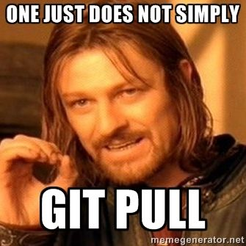

Slide 28
for loops: for dictionaries
>>> states = {"VA": "Virginia", "MD": "Maryland"}
for code, state in states.items():
print(code + " is the code for " + state)

Slide 29
range
for i in range(10):
print("I'm at number " + str(i))
for i in range(5, 10):
print("I'm at number " + str(i))
for i in range(0, 10, 2):
print("I'm at number " + str(i))

Slide 30
Fun with Lists
list.append(item) # add item to end of list
list.index(item) # searches for item & gives its index
list.remove(item) # removes first item of that name
list.reverse() # reverses the order of a list
len(list) # gives number of items in list
list.count(item) # counts number of that item in list
There are many more methods and things to do with list! See the List documentation here and here.

Slide 31
Branching: Do something only under certain circumstances
if fruits[0] == "plum":
print(fruits[0])
Remember: = is assignment, == is equivalence
Python one-liner:
>>> if fruits[0]=="plum":print(fruits[0])

Slide 32
Branching: Do something only under certain circumstances
Use else and elif for compound conditions. Remember the "and" and "or" operators?
if fruits[0] == "apple":
print("Yum!")
elif fruits[0] == "cardboard" or fruits[0] == "sand":
print("Yuck!")
else:
print("Not bad.")

Slide 33
Branching
if "apple" not in fruits[0]:
print("Yuck")
age = 5
if age > 0 and age <= 2:
print("baby")
elif age > 2 and age < 18:
print("child")
else:
print("adult")

Slide 34
while loop
continues while a condition is true
like an for loop with an if
counter = 0
while counter < 5:
print(counter)
counter += 1
Remember: += is shorthand for counter = counter + 1

Slide 35
“until” loop
There is no “do x until y” loop in Python, but while loops can be modified to continue until a condition is met:
counter = 0
while True:
if counter <= 5:
print(counter) counter += 1
if counter > 5:
break
Remember: = is assignment, == is equivalence

Slide 36
slice
>>> alphabet = "abcdefghijklmnopqrstuvwxyz"
>>> alphabet[1]
"b"
>>> alphabet[2:7]
"cdefg"
>>> alphabet[-2:]
"yz"
>>> list = ["a", "b", "c", "d", "e"]
>>> list[:-1]
['a', 'b', 'c', 'd']
For more see the documentation!

Slide 37
Packages
Useful behavior beyond the "basics"
Python Standard Library
Math functions
Everything we've done so far
Python packages
Just about everything else
Anythin you might not need to use everytime

Slide 38
Installing Packages
How do you get them on your computer?
pip – stands for “Pip installs packages.” Does what it says
$ pip install a_package
Or
$ pip3 install a_different_package
Remember that we have different Python versions! Installing to one won’t install to the other.
Then import them in your code with:
import a_package_name

Slide 39
Installing Packages
For example, NLTK is a text analysis package that isn't loaded by default. To install it –
$ pip install nltk
or
$ pip3 install nltk
then in your program
import nltk
Note: some packages require additional installations and configurations! The documentation can help.

Slide 40
Organization: code reuse
Methods
Name code (like variables that name strings and numbers)
Take arguments
"Mini-scripts" || "Tiny commands"
Allows for code reuse
Make it easier to debug
def add(x, y):
print(x + y)
number = 4
add(3, number)

Slide 41
Methods
def method_name():
# what the method does!
All methods start with a def.

Slide 42
Methods
def method_name():
…
…
method_name()
-nothing happens when you declare a method.
- you have to call it later to execute it.

Slide 43
Methods
A method is a way of reusing the same bit of code.
DRY – Don't Repeat Yourself
print("Hi my name is Tony")
print("Hi my name is Brandon")
print("Hi my name is Ethan")
print("Hi my name is Maple")

Slide 44
Methods
A method is a way of reusing the same bit of code.
DRY – Don't Repeat Yourself
def say_hello(name):
print("Hi my name is " + name)
say_hello("Brandon")

Slide 45
Methods
say_hello("Brandon")
say_hello("Tony")
say_hello("Ethan")
say_hello("Maple")
More DRY, but we could do even better! remember our loops?

Slide 46
Methods
def say_hello(name):
print("Hi my name is " + name)
names = ["Brandon", "Tony", "Ethan", "Maple"]
for name in names:
say_hello(name)
Pretty clearly separating the data from the use of it. Nice! SO DRY

Slide 47
Variable Scope
# This is a global variable
a = 0
if a == 0:
# This is still a global variable
b = 1
def my_function(c):
# this is a local variable
d = 3
print(c)
print(d)
# Now we call the function, passing the value 7 as the first and only parameter
my_function(7)
# a and b still exist
print(a)
print(b)
# c and d don't exist anymore -- these statements will give us name errors!
print(c)
print(d)
Taken from http://python-textbok.readthedocs.io/en/1.0/Variables_and_Scope.html
Notes:
Different variable types only activate in certain parts of a code. Remember the do block with |fruit|? Fruit cease to exist outside that do block. We can organize the access of information in our code. Organization is your best defense against bugs.

Slide 48
Exercise
Write your own method!
Try to write another method that calls the first method.
Why might you want to do this?
Share with your neighbor

Slide 49
Exercise
Create a collection of texts and metadata about them. Then, print out information about those texts using a method.
Example Data for your Collection:
Jane Eyre, 1847
Cane, 1923
Wide Sargasso Sea, 1966
Citizen: An American Lyric, 2014
Example output you might aim for:
Jane Eyre was published in 1847.

Slide 50
An Answer
texts = {
"Jane Eyre": "1847",
"Cane": "1923",
"Wide Sargasso Sea": "1966",
"Citizen: An American Lyrics": "2014"
}
for title, date in texts.items():
print(title + " was published in " + date)

Slide 51

Real World

Slide 52
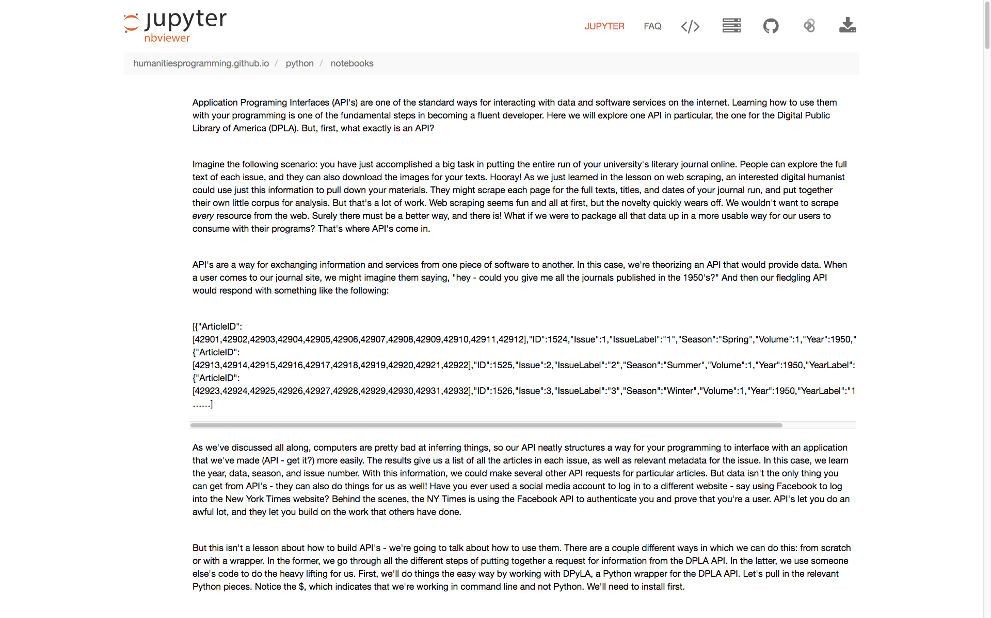
Looking Ahead
Notes:
One of our case studies works with the DPLA API

Slide 53
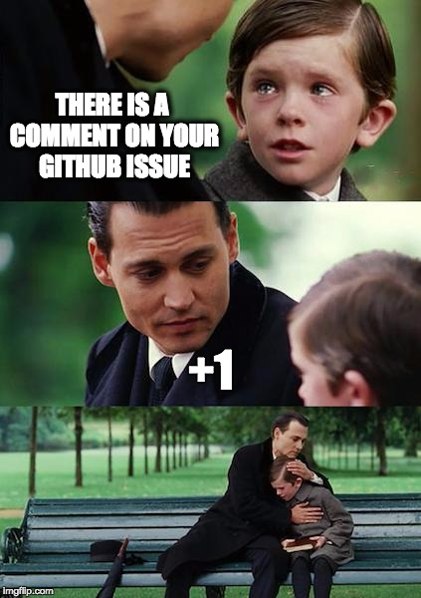

Slide 54
Exercise
This one is more difficult! So let's just think through it but not code it. What are the pieces you would need?
Create a list containing containing ten words, but make a few of them variant spellings of the same word. Write a program that looks through this list and makes a copy of the original list but with standardized spellings
words = ['color','color','colour','amok','amok','amuck','adviser','advisor','adviser','pepper']
canonical_spellings = ['color','amuck','adviser','pepper']

Slide 55
An Approach
words = ['color','color','colour','amok','amok','amuck','adviser','advisor','adviser','pepper']
canonical_spellings = ['color','amuck','adviser','pepper']
# could use a dictionary to convert!
mappings = {'colour':'color','amok':'amuck','advisor':'adviser'}
new_list = []
for word in words:
# 1. if word is misspelled add the corrected spelling to the new list.
# 2. otherwise add the standard spelling.

Slide 56
An Approach
words = ['color','color','colour','amok','amok','amuck','adviser','advisor','adviser','pepper']
canonical_spellings = ['color','amuck','adviser','pepper']
# could use a dictionary to convert!
mappings = {'colour':'color','amok':'amuck','advisor':'adviser'}
new_list = []
for word in words:
# 1. if word is misspelled add the corrected spelling to the new list.
# 2. otherwise add the standard spelling.

Slide 57
An Approach Cont.
words = ['color','color','colour','amok','amok','amuck','adviser','advisor','adviser','pepper']
canonical_spellings = ['color','amuck','adviser','pepper']
# could use a dictionary to convert!
mappings = {'colour':'color','amok':'amuck','advisor':'adviser'}
new_list = []
# go over each word and look to see if it exists as a key in the mapping dict.
# the keys are mispellings. if the key exists, we know we're on a misspelled word!
# if the key doesn't exist, it's spelled right already. So we can just append that.
for word in words:
if word in mappings:
new_list.append(mappings[word])
else:
new_list.append(word)
print(new_list)

Slide 58
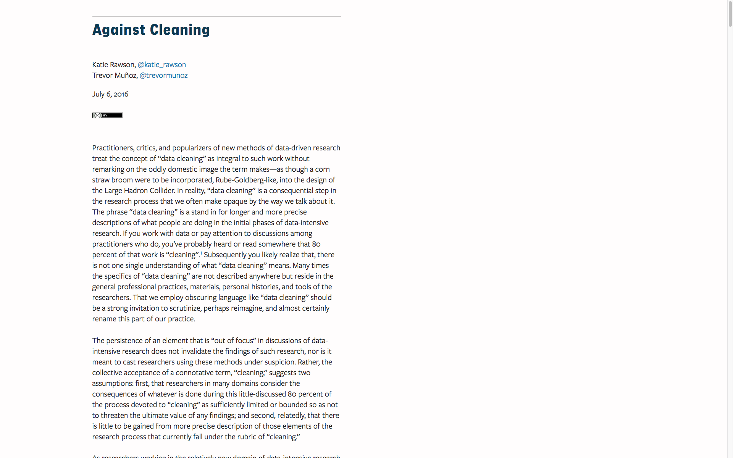
Real World Connection - Name Disambiguation and Against Cleaning
http://curatingmenus.org/articles/against-cleaning/

Slide 59


Slide 60
Exercise
We want scrape a number of pages from my blog. In order to do that, we'll need a list of several URLs to point our Python program to. We know the name of each page we are interested in, and we know the top-level domain. Make a new list consisting of all the URLs we want by combining the two.
domain = 'http://walshbr.com/'
pages = ['about','blog','pedagogy','projects','cv']

Slide 61
An Answer
domain = 'http://walshbr.com/'
pages = ['about','blog','pedagogy','projects','cv']
urls = []
for page in pages:
url = domain + page
urls.append(url)
urls
Notes:
Use this as an opportunity to describe webscraping – pass in a series of URLS. Using Beautiful Soup, we could take each of these urls and do something with them. Try going back to the command line and typing
$ curl http://walshbr.com

Slide 62
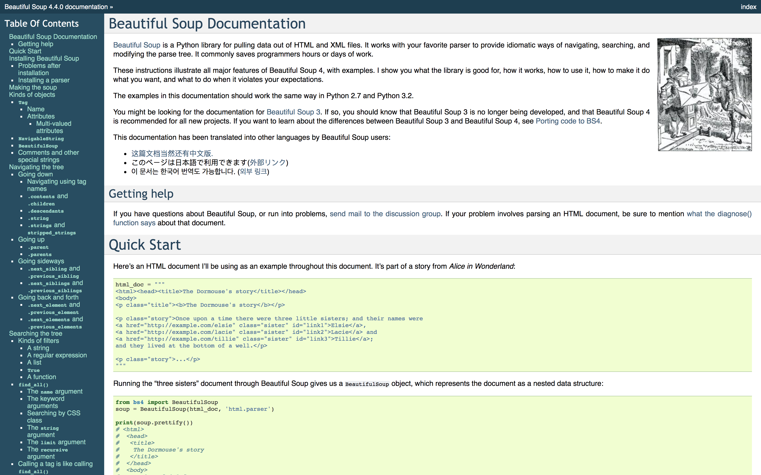
Real World Connection - Web Scraping
https://www.crummy.com/software/BeautifulSoup/bs4/doc/

Slide 63


Slide 64
Questions?

